Slide 1
Project-Based Learning to Build Writing Skills in a
Social Work Curriculum
Andrea Tamburro, EdD, MSW, BSW Program Director, Indiana University Northwest
Marshelia Harris, MSW
Lecturer, Indiana University Northwest
Dona Young, MA (Curriculum and Instruction) Adjunct, Indiana University Northwest

Slide 2
Our Process – Our Team
Dona
Marshelia
Andrea

Slide 3
Our Mission
Take an integrative approach to improving our students’ writing skills and critical thinking skills

Slide 4
What’s difficult about teaching writing in a social work curriculum?
What challenges do you face?

Slide 5
Social Work Curriculum
Case-Based Learning – applying scenarios, role playing, experiential
Problem-Based Learning – resolving an issue or finding solutions, experiential
Inquiry-Based Learning – solving or resolving questions
Project-Based Learning – solving problems, building skill, experiential (but not as obvious to the student)
Example: Literature Review

Slide 6
Project-Based Learning
Instructor develops a framework for a project that helps students learn information and improve skills.
The value and importance of the information and skills may not be obvious to the students.

Slide 7
What is Project-Based Learning?
Goals
Rationale
Competencies
Expected outcomes
Framework
Steps or increments (incremental learning)
Regular feedback (at intervals coinciding with steps)
Skill building

Slide 8
The Why and When of
Project-Based Learning
Projects help students understand why they need the knowledge and skills they identify as essential to completing the projects.
Recognize and fill learning gaps
Improve motivation
Increase retention and graduation
Transfer learning to new projects
Meet the needs of global and analytic learners

Slide 9
Global and Analytic Learners
Global learners need to see the whole picture – they need the entire map of the project.
Analytic learners need the details – their learning is reinforced by the step-by-step details.

Slide 10
Project-Based Learning
Literature Review
Research Interview
DEAL Model
Documentation of Social Work Cases

Slide 11
Project-Based Literature Review
Step 1: Thesis Statement
Step 2: Introduction and Review
  Two Social Work Articles
      Summarize the article
      Assess and critique the article
      Reflect on the article – will it inform your thesis statement?

Slide 12
Step 3: Synthesize 10 Articles
Article | Topic 1 | Topic 2 | Topic 3 | Topic 4 | Topic 5
 | Define neglect | Ways to identify neglect | Reasons for neglect | Interventions for neglect | Outcomes
Smith (2008) | X – agree |  | X | X
Jones (2010) | X – disagree | X
Johnson (2013) | X – agree |  | X | X | X
Thigpen (2012) | X brief |  | X | X | X

Slide 13
Steps 4 through 6 . . .
Step 4: Conclusion of first draft
Step 5: Conclusion of second draft
Step 6: Presentation of Literature Review (PowerPoint)

Slide 14
Step 7: Final Literature Review
Outline:
Title Page
Introduction (thesis statement or question)
Annotated bibliography for each article:
    Summary
    Assessment and Critique
    Reflection
Synthesis
Conclusion
References

Slide 15
Documentation in the Field
Court Summaries
Social Histories
Client Intake Forms
Treatment Plans
Case Notes
Résumés

Slide 16
Classroom Writing Activities
Letters to Editors
Letters to Legislators
Journaling and Self-Reflection
Process Recordings
Brochures and Flyers
Poster Board Presentations
Case Analysis
Program Proposals

Slide 17
Intensive Writing Courses
General education requirements for Indiana University
Two intensive writing courses at the undergraduate level in the School of Social Work
Series of written assignments
Stages of development for assignments
Gradually move from small to large written assignments

Slide 18
Do some of your students have editor’s block?
  Editor’s block results from focusing on the product rather than the process.

Slide 19
Editor’s Block
Type A:
  You edit as you compose, and your ideas get jammed in your head or dissolve before they reach the page.
Type B:
  You do not proofread or edit your work because you feel anxious about mistakes or are unsure of what to correct.

Slide 20

What’s the solution?

Slide 21
Compose Fearlessly
Freewriting
Focused Writing
Mind Maps
Page Maps
Fishbone Diagrams
Scratch Outlines and Notes
Work Journals
If you hold it in, it will destroy you; if you let it out, it will free you.

Slide 22
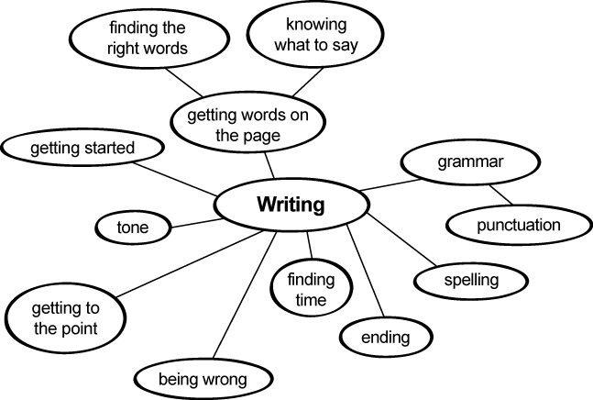
Mind Maps

Slide 23
Edit Ruthlessly
Punctuation (the key to editing skills)
Active Voice
Parallel Structure
Pronoun Point of View
Word Usage
Capitalization and Number Usage

Slide 24
Formatting
Readers assess credibility at a glance.
E-Mail
Business Letters
Documentation in the Field
Job-Search Documents
APA Citation and Formatting

Slide 25
Development of Materials
Motivation
New Generation –
  Quick
  Overburdened
  Hands-on

Slide 26
Application Activity
Two Topics
Groups of 3 – 4
What is another project-based learning activity that can enhance writing?
How can you incorporate into your curriculum more project-based learning activities that strengthen writing skills?

Slide 27
Guidelines for Developing Projects
Begin with the end in mind: Plan for the end result
Craft the driving question: Select and refine a central question
Plan the assessment: Define outcomes and assessment criteria
Map the project: Decide how to structure the project
Manage the process: Develop tools and strategies for successful projects
"Project-Based Learning Online Course and Instructor's Manual," (2007)

Slide 28

Questions

Slide 29

Stop by and see us ….
Please contact us at:
Marshelia Harris
mdharris@iun.edu
219.981.5630
Andrea Tamburro
atamburr@iun.edu
219.980.6703
Dona J. Young
dona.young@earthlink.net
219.763.9794

Slide 30
About the Authors
Dona Young, MA, teaches professional writing online at Indiana University Northwest. She earned an MA in education from The University of Chicago and a BA in sociology from Northern Illinois University, with minors in secondary education and business education. Young believes that writing is a powerful learning tool and that learning shapes our lives; she is also the author of the following textbooks: Business Communication and Writing (Writer’s Toolkit Publishing, 2012), Business English (McGraw-Hill Higher Education, 2008), and Foundations of Business Communication (McGraw-Hill Irwin, 2006), among others.
Marshelia Harris, MSW, teaches policy, administration, and child welfare across the bachelor and master of social work programs at Indiana University Northwest. Harris received her MSW from Indiana University Northwest and BS in graphic arts management from Indiana State University. She is a licensed child welfare specialist with the state of Illinois and has several years of administrative experience in social services. Harris has developed new programs, facilitated training sessions, and managed parenting and non-parenting youth programs, case management and clinical services, and program budgets.
Andrea Tamburro, Ed.D. and MSW, is a member of the Shawnee Tribe and is the Bachelor of Social Work Program Director at Indiana University on the Northwest campus. She teaches policy, research, and practice. She earned her education doctorate from Simon Fraser University in British Columbia, Canada, and her master of social work through the University of Iowa. Tamburro’s main research area is indigenous social work education; her practice areas include child welfare, mental health, domestic violence, and criminal justice.

